Slide 1
CHAPTER 2 PROBLEM SOLVING
By: Nida Munawar

Slide 2
This chapter will cover the following topics:
Problem Solving Concepts for the Computer
Pre-Programming Phase
Programming Or Implementation Phase

Slide 3
What Problem Can Be Solved By Computer
When the solution can be produced by a set of step-by-step procedures or actions.
This step-by-step action is called an algorithm.
The algorithm will process some inputs and produced output.
Solving problem by computer undergo two phases:
Phase 1:
Organizing the problem or pre-programming phase.
Phase 2:
Programming phase.

Slide 4
PRE-PROGRAMMING PHASE
This phase requires five steps:
Analyzing the problem.
Developing the Hierarchy Input Process Output (HIPO) chart or Interactivity Chart (IC).
Developing the Input-Process-Output (IPO) Chart.
Drawing the Program flowcharts.
Writing the algorithms.

Slide 5
PRE-PROGRAMMING PHASE
Analyzing The Problem
Understand and analyze the problem to determine whether it can be solved by a computer.
Analyze the requirements of the problem.
Identify the following:
Data requirement.
Processing requirement or procedures that will be needed to solve the problem.
The output.

Slide 6
PRE-PROGRAMMING PHASE
All These requirements can be presented in a Problem Analysis Chart (PAC)
Data | Processing | Output
given in the problem or provided by the user | List of processing required or procedures. | Output requirement.

Slide 7
PRE-PROGRAMMING PHASE
Example: Payroll Problem
Calculate the salary of an employee who works by hourly basis. The formula to be used is
Salary = Hour works * Pay rate
Data | Processing | Output
Hours work, Pay rate | Salary = Hours work * payrate | Salary

Slide 8
Problem 1
Write a Problem Analysis Chart (PAC) to convert the distance in miles to kilometers where 1.609 kilometers per mile.
Data | Processing | Output
Distance in miles | Kilometers = 1.609 x miles | Distance in kilometers

Slide 9
Problem 2
Write a Problem Analysis Chart (PAC) to find an area of a circle
where area = pi * radius * radius
Data | Processing | Output
radius | area = 3.14 x radius x radius | area

Slide 10
Problem 3
Write a Problem Analysis Chart (PAC) to compute and display the temperature inside the earth in Celsius and Fahrenheit. The relevant formulae are
Celsius = 10 x (depth) + 20
Fahrenheit = 1.8 x (Celsius) + 32
Data | Processing | Output
depth | celsius = 10 x (depth) + 20 fahrenheit = 1.8 x (celsius) + 32 | Display celsius, Display fahrenheit

Slide 11
PRE-PROGRAMMING PHASE
Developing the Hierarchy Input Process Output (HIPO) or Interactivity Chart
The problem is normally big and complex.
Thus, requires big program.
It provides high level view of the system (low details)
Thus, the processing can be divided into subtasks called modules.
Each module accomplishes one function.
These modules are connected to each other to show the interaction of processing between the modules.

Slide 12
PRE-PROGRAMMING PHASE
Main/control module controls the flow all other modules.
The IC is developed using top-down-method: top to down left to right order (also refer to order of processing).
Modules are numbered, marked for duplication, repetition or decision.

Slide 13
PRE-PROGRAMMING PHASE
The interaction will form a hierarchy, called Hierarchy Input Process Output Chart (HIPO) or Interactivity Chart (IC). Programming which use this approach (problem is divided into subtasks) is called Structured Programming.
Main Module
Module 1
Module 2
Module 3
Module 4
Module 5
Module 6

Slide 14
PRE-PROGRAMMING PHASE
PAYROLL
0000
READ
1000
CALCULATE
2000
PRINT
3000

Slide 15
Problem 1
Write a Hierarchy Input Process Output (HIPO) to convert the distance
in miles to kilometers where 1.609 kilometers per mile.
Convert the distance
0000
Distance in miles
1000
Kilometers = 1.609
x miles
2000
Distance in
Kilometers
3000

Slide 16
Problem 2
Write a Hierarchy Input Process Output (HIPO) to find an area of a circle where area = pi * radius * radius
Area
0000
radius
1000
area = 3.14 x
radius x radius
2000
Display area
3000

Slide 17
Problem 3
Write a Hierarchy Input Process Output (HIPO) to compute and display the temperature inside the earth in Celsius and Fahrenheit. The relevant formulas are
Celsius = 10 x (depth) + 20
Fahrenheit = 1.8 x (Celsius) + 32
Temperature
0000
Calculate temperature
in celsius
1000
Get depth
1100
Calculate temperature
In fahrenheit
2000
Display
Temperature
3000

Slide 18
Problem 4
Write a PAC and Hierarchy Input Process Output (HIPO) that asks a user to enter the distance of a trip in miles, the miles per gallon estimate for the user’s car, and the average cost of a gallon of gas. Calculate and display the number of gallons of gas needed and the estimated cost of the trip.

Slide 19
Data | Processing | Output
distance, miles per gallon, cost per gallon | gas needed = distance / miles per gallon. estimated cost = cost per gallon x gas needed | Display gas needed Display estimated cost

Slide 20
Estimation Cost
0000
Calculate gas
Needed
1000
Get total distance
in miles
1100
Get miles
per gallon
1200
Calculate estimated
Cost
2000
Get average cost
per gallon
2100
Display gas needed
Display estimated
Cost
3000

Slide 21
PRE-PROGRAMMING PHASE
Example 2.2: Extended Payroll Problem
You are required to write a program to calculate both the gross pay and the net pay of every employee of your company. To determine the gross pay, you have to multiply the accumulated total hours worked by the employee, by the appropriate pay rate. The program should print the cheque that tells the total net pay. The net pay is calculated by subtracting the gross pay with any deductions that may be incurred by the employee.

Slide 22
PRE-PROGRAMMING PHASE
Payroll
0000
Calculate
Gross Pay
1000
Calculate
Net Pay
2000
Write
Cheque
3000
Accumulate
Hourly
Worked
1100
Determine
Pay rate
1200
Calculate
Deductions
2100

Slide 23
PRE-PROGRAMMING PHASE
Developing the Input Process Output (IPO) Chart
Extends and organizes the information in the Problem Analysis Chart.
It shows in more detail what data items are input, what are the processing or modules on that data, and what will be the result or output.
It combines information from PAC and HIPO Chart.

Slide 24
PRE-PROGRAMMING PHASE
Input | Processing | Module | Output
-Hours Worked -Pay Rate -Deduction | -Enter Hourly Worked -Enter Pay Rate -Calculate Gross Pay -Enter Deductions -Calculate Net Pay -Print Cheque -End | 1100 1200 1000 2100 2000 3000 0000 | -Net pay

Slide 25
Problem 1
Write a Input Process Output (IPO) to convert the distance in miles to kilometers where 1.609 kilometers per mile.
Input | Processing | Module | Output
-Distance in Miles | -Enter distance -Kilometers = 1.609 x distance -Display kilometers | 1000 2000 3000 | -Distance in kilometers

Slide 26
Problem 2
Write a Input Process Output (IPO) to find an area of a circle
where area = pi * radius * radius
Input | Processing | Module | Output
- radius | - Enter radius - area = 3.14 x radius x radius Display area end | 1000 2000 3000 0000 | - Area of a circle

Slide 27
Problem 3
Write an Input Process Output (IPO) that asks a user to enter the distance of a trip in miles, the miles per gallon estimate for the user’s car, and the average cost of a gallon of gas. Calculate and display the number of gallons of gas needed and the estimated cost of the trip.

Slide 28
Input | Processing | Module | Output
Distance in miles Miles per gallon Cost gas per gallon | Enter distance Enter miles per gallon Calculate total gas needed Enter cost gas per gallon Calculate estimated cost Display total gas and estimated cost End | 1100 1200 1000 2100 2000 3000 0000 | Total gas needed Estimated cost

Slide 29
PRE-PROGRAMMING PHASE
Drawing the Program Flowcharts
Flowchart is the graphic representations of the individual steps or actions to implement a particular module.
The flowchart can be likened to the blueprint of a building. An architect draws a blueprint before beginning construction on a building, so the programmer draws a flowchart before writing a program.
Flowchart is independent of any programming language.

Slide 30
PRE-PROGRAMMING PHASE
Flowchart is the logical design of a program.
It is the basis from which the actual program code is developed.
Flowchart serves as documentation for computer program.
The flowchart must be drawn according to definite rules and utilizes standard symbols adopted internationally.
The International Organization for Standardization (IOS) was the symbols shown below (You can draw the symbols using ready-made flowcharting template):

Slide 31
PRE-PROGRAMMING PHASE
Symbol | Function
 | Show the direction of data flow or logical solution. (Direction symbol)
 | Indicate the beginning and ending of a set of actions or instructions (logical flow) of a module or program. (An End or a Beginning)
 | Indicate a process, such as calculations, opening and closing files. (Process symbol)

Slide 32
PRE-PROGRAMMING PHASE
 | Indicate input to the program and output from the program.
 | Use for making decision. Either True or False based on certain condition. (a Decision)
 | Use for doing a repetition or looping of certain steps. (Input & Output symbol)
 | Connection of flowchart on the same page. (Connecting Symbols)
 | Connection of flowchart from page to page. (Off page connector)

Slide 33
PRE-PROGRAMMING PHASE
Example 2.3 : Sale Problem
Draw a flowchart for a problem that to read two numbers. The first number represents the unit price of a product and the second number represents the quantity of the product sold. Calculate and print the total sale.
Solution: Stepwise Analysis of the Sale Problem
Start of processing
Read the unit price
Read the quantity
Calculate total sale
Print total sale
Stop the processing

Slide 34
PRE-PROGRAMMING PHASE
START
A
READ
UNIT PRICE
TOTAL SALE =
UNITPRICE × QUANTITY
READ
QUANTITY
PRINT
TOTALSALE
A
STOP

Slide 35
PRE-PROGRAMMING PHASE
Finding Average Problem
Read a sequence of number, find the average of the number and print the average.
Solution: Stepwise Analysis of Average Problem
Start the processing
Read a number
Add the number
Repeat reading until last data
Calculate the average
Print the average
Stop the processing

Slide 36
PRE-PROGRAMMING PHASE
START
READ
NUMBER
ACCUMULATE
TOTAL
Repetition until end of data
CALCULATE
AVERAGE
PRINT
AVERAGE
STOP

Slide 37
PRE-PROGRAMMING PHASE
START
X
COUNTER= 0
TOTAL=0
AVERAGE = TOTAL
COUNTER
READ NUMBER
PRINT AVERAGE
TOTAL = TOTAL + NUMBER
COUNTER = COUNTER + 1
STOP
END OF DATA
X

Slide 38
PRE-PROGRAMMING PHASE
TASK:
Draw a flow chart to print the sum of all even numbers between 1 to n.

Slide 39
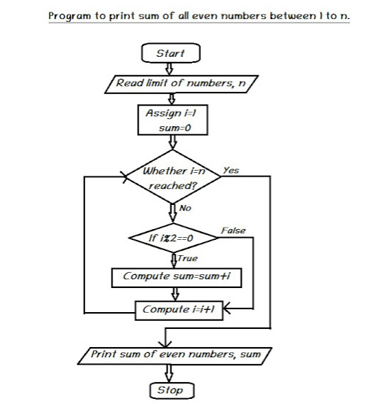

Slide 40
PRE-PROGRAMMING PHASE
Writing the Algorithm
The solution to any computing problem involves executing a series of actions in a specific
order. A procedure for solving a problem in terms of
1. the actions to be executed, and
2. the order in which these actions are to be executed
is called an algorithm.
Specifying the order in which statements are to be executed
in a computer program is called program control

Slide 41
PRE-PROGRAMMING PHASE
Writing the (Pseudocode)
Pseudocode is a generic code like language that can be easily written in any programming language
It is used in place of symbols or a flowchart to describe the logic of a program. Thus, it is a set of instructions (descriptive form) to describe the logic of a program.
Pseudocode is close to the actual programming language.
Using the Pseudocode, the programmer can start to write the actual code.
E.g
Begin Adding two numbers() Input number 1 Input number 2 number 3= number 1+ number 2 Output Number 3 End

Slide 42
START
READ
PRICE
Algorithm:
Start Read price, quantity
Sale = price x quantity
Print Sale End
READ
QUANTITY
SALE = PRICE ×
QUANTITY
PRINT
SALE
STOP

Slide 43
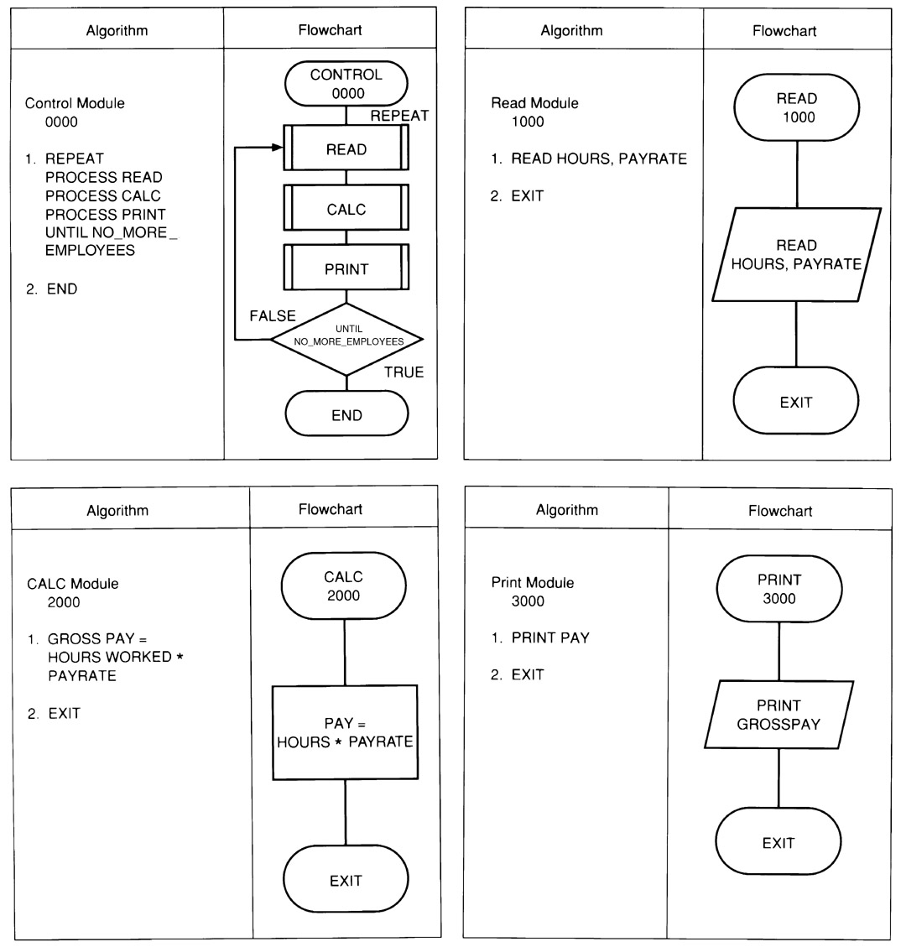
Example: Flowchart & Algorithm

Slide 44
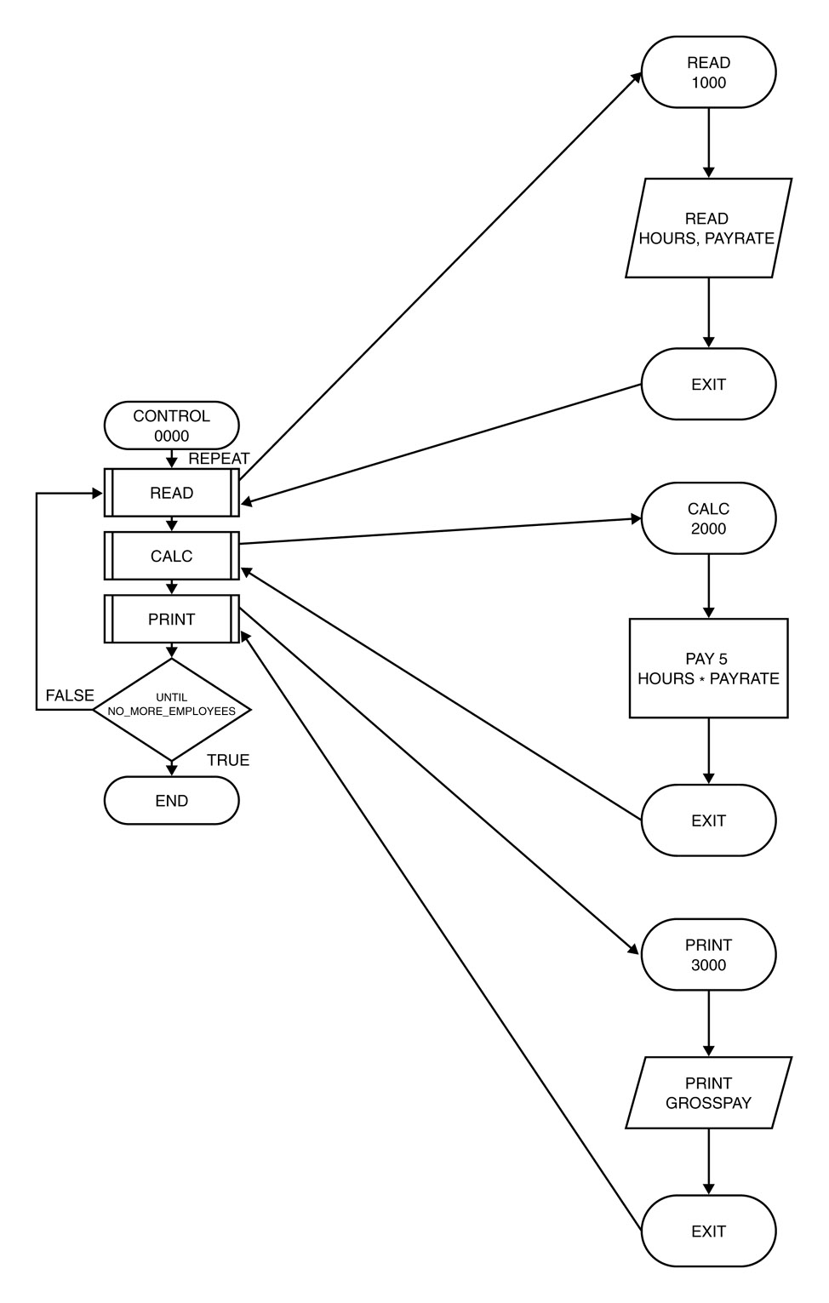
Order of Execution of Instructions : Payroll System

Slide 45
Structuring a Program
Develop efficient computer solution to problems:
Use Modules
Use 3 Control Structures/logic structures
Sequential structure
Executes instructions one after another in a sequence.
Decision structure
Branches to execute one of two possible sets of instructions.
Loop structure
Executes set of instruction many times.
Eliminate rewriting of identical process by using modules.
Use techniques to improve readability including 3 logic structure, proper naming of variables, internal documentation and proper indentation.

Slide 46
Control Structures
programs could be written in terms of only three control structures, namely the sequence structure, the selection structure and the repetition structure.
sequence structure
The sequence structure is simple—unless directed otherwise,
the computer executes statements one after the other in the order in which they’re
written.

Slide 47
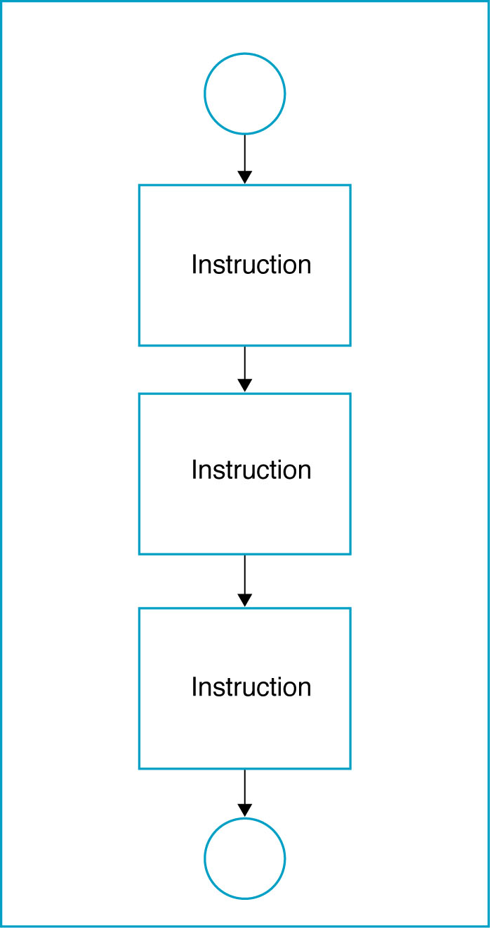
a. Sequential Logic Structure

Slide 48
b. Decision structure
Selection Statements : Ask a question which path to take next.
three types of selection structures in the form of statements.
The if selection statement either selects (performs) an action if a condition is true or skips the action if the condition is false. (single-selection statement )
The if…else selection statement performs an action if a condition is true and performs a different action if the condition is false. (double-selection statement )
The switch selection statement performs one of many different actions, depending on the value of an expression. (multiple-selection statement because it selects among many different actions)

Slide 49
Decision Logic Structure
Implements using the IF/THEN/ELSE instruction.
Tells the computer that IF a condition is true, THEN execute a set of instructions, or ELSE execute another set of instructions
ELSE part is optional, as there is not always a set of instructions if the conditions are false.
Algorithm:
IF <condition(s)> THEN
<TRUE instruction(s)>
ELSE
<FALSE instruction(s)

Slide 50
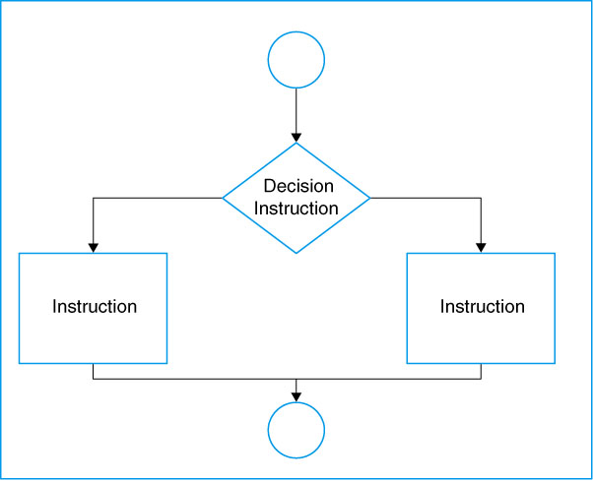
Decision Logic Structure

Slide 51
Examples of conditional expressions
A < B (A and B are the same data type – either numeric, character, or string)
X + 5 >= Z (X and Z are numeric data)
E < 5 or F > 10 (E and F are numeric data)

Slide 52
Example
Assume your are calculating pay at an hourly rate, and overtime pay(over 40 hours) at 1.5 times the hourly rate.
IF the hours are greater than 40, THEN the pay is calculated for overtime, or ELSE the pay is calculated in the usual way.

Slide 53
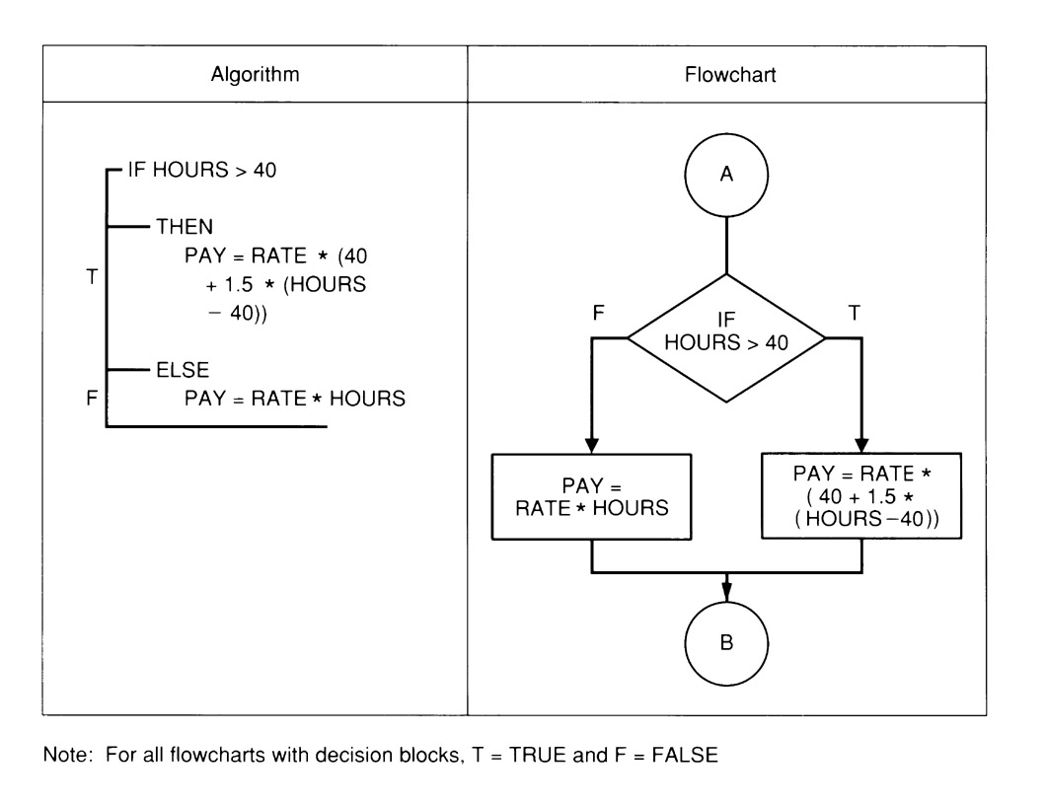
Example Decision Structure

Slide 54
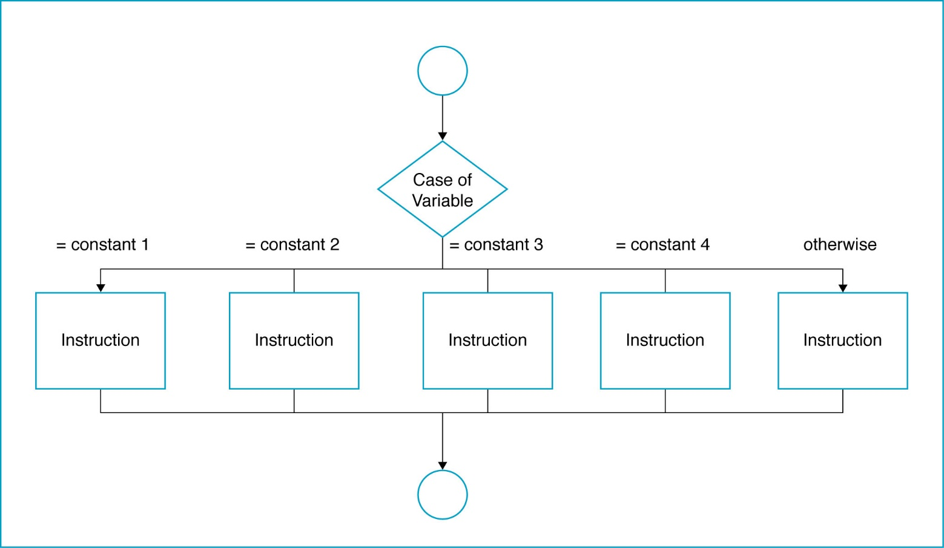
The Case Logic Structure
Made up of several or many sets of instructions, only one of which will be selected by the user and executed by the computer

Slide 55
Case Logic Structure
Example: A company has four different medical plans. The programmer has given each plan a code corresponding to the beginning initial of the company: Plan 1 = F, Plan 2 = B, Plan 3 = K, Plan 4 = E.
The company pays for all of Plan 1. The individual has to pay for part of the others. The payroll deduction for Plan 2 = 4.65, for Plan 3 = 7.85, and for Plan 4 = 5.50. Any other codes are considered in error.
Write the algorithm and draw the flowchart for a module to determine the payroll deduction.

Slide 56
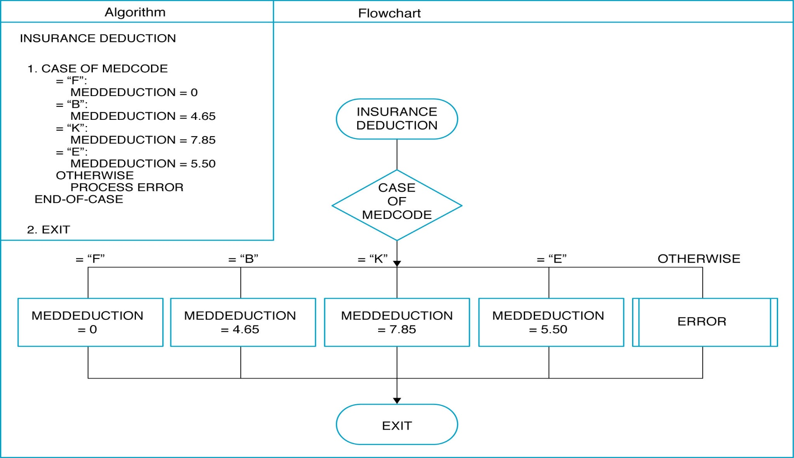
Example of Case Logic Structure

Slide 57
NESTED IF/THEN/ELSE INSTRUCTIONS
Multiple decisions.
Instructions are sets of instruction in which each level of a decision is embedded in a level before it.

Slide 58
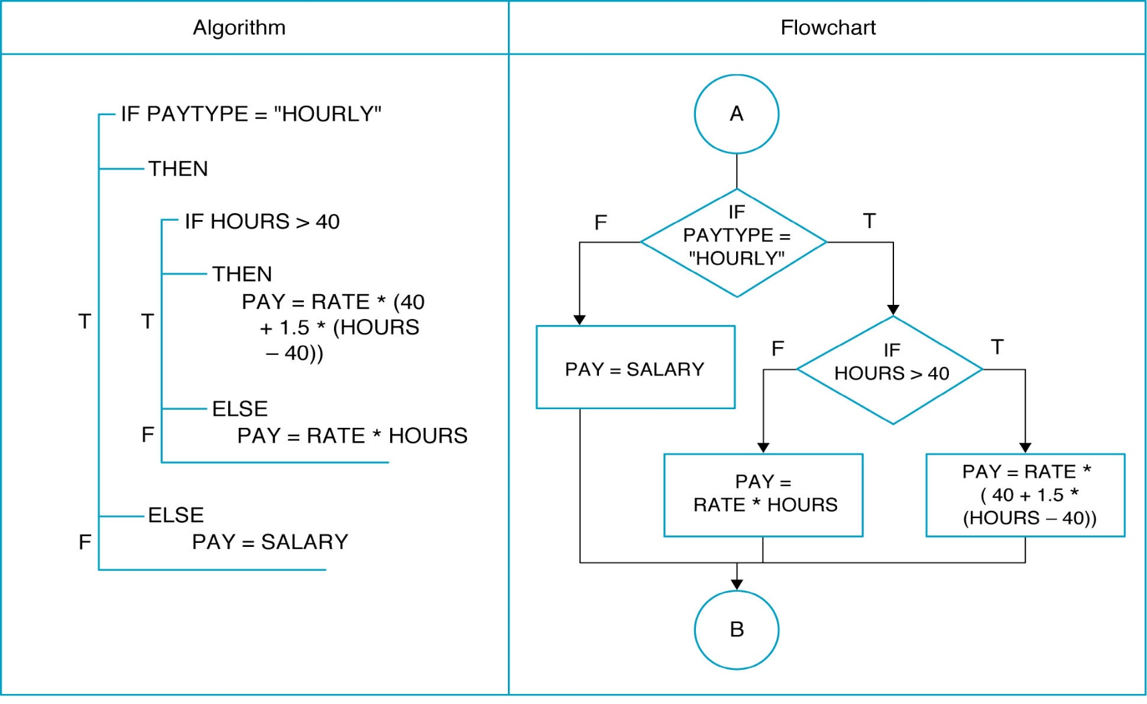
NESTED IF/THEN/ELSE INSTRUCTIONS

Slide 59
c. Loop Logic Structure
Repetition Statements : Ask a question over and over again , until certain task is completed
To solve the problem that doing the same task over and over for different sets of data
three types of repetition structures in the form of statements, namely while
, do…while, and for
Types of loop:
WHILE loop
Do WHILE loop
For loop
only seven control statements: sequence, three types of selection and three types of repetition, there’s only one other way control statements may be connected—a method called control-statement nesting

Slide 60
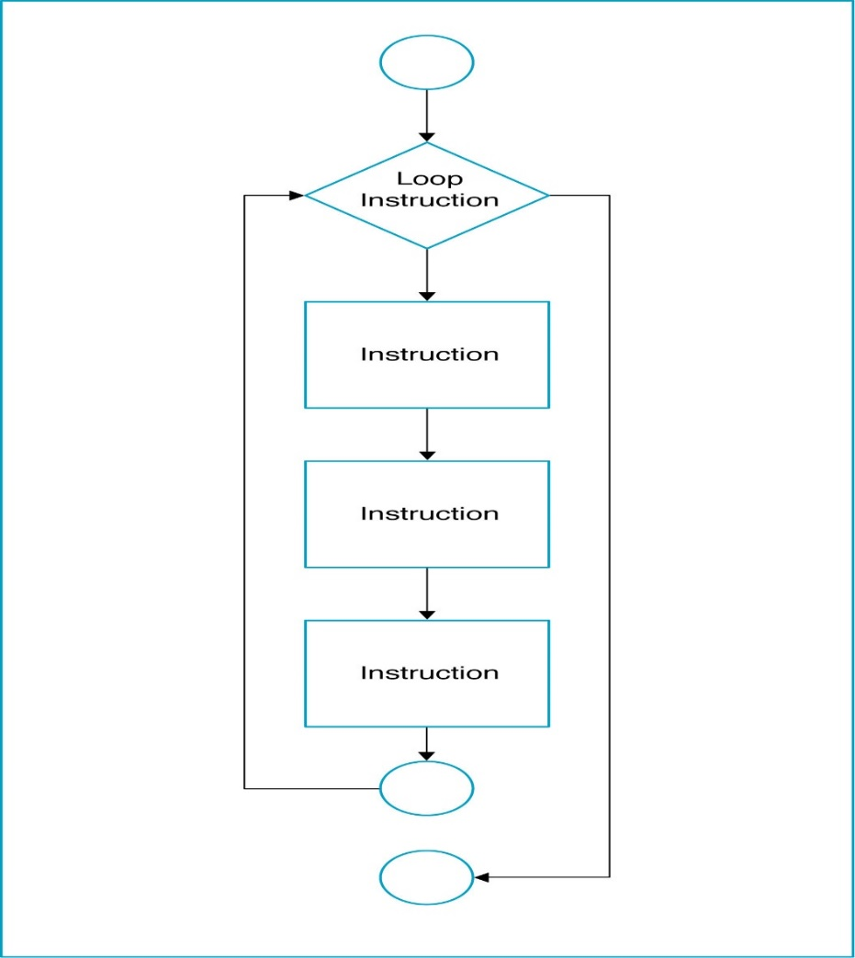
Loop Logic Structure

Slide 61
WHILE loop
Do the loop body if the condition is true.
Example: Get the sum of 1, 2, 3, …, 100.
Algorithm:
Set the number = 1
Set the total = 0
While (number <= 100)
total = total + number
number = number + 1
End While
Display total

Slide 62
WHILE loop
Start
Set number = 1
Set total = 0
number <= 100
No
Yes
Display total
total =
total + number
End
number =
number + 1

Slide 63
DO WHILE Loop
The body of the loop will process first before check the condition.
Example: Get the sum of 1, 2, 3, …100.

Slide 64
DO WHILE Loop
Start
Set number = 1
Set total = 0
total =
total + number
No
number =
number + 1
Display total
Yes
number <= 100
End

Slide 65
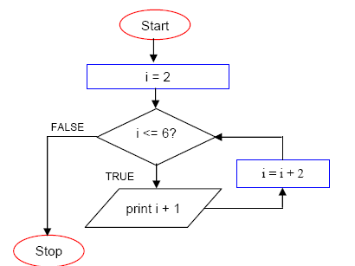
For Loop

Slide 66
TASK
Write an algorithm and also draw a flowchart to login to facebook account

Slide 67
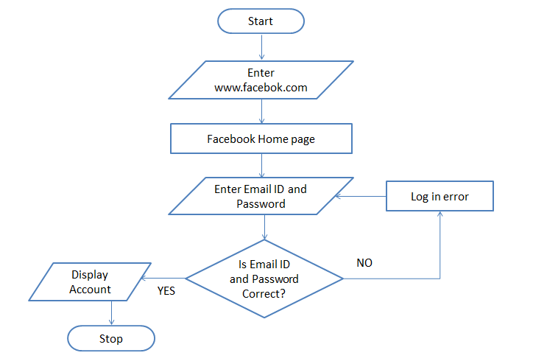
TASK
Write an algorithm and also draw a flowchart to login to facebook account
Enter www.facebook.com in your browser. (I/O)
facebook Home page loads (PROCESS)
Enter your Email ID and Password (I/O)
Is Email ID and Password Valid (DECISION)
if NO then Log in error (PROCESS) go to step 3 else Display Facebook Account (I/O) Stop

Slide 68
TASK
Write Algorithm & Flowchart to print multiplication Table of a number.

Slide 69
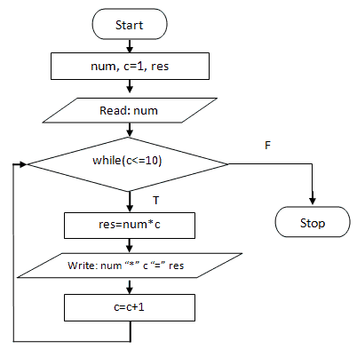
TASK
Write Algorithm & Flowchart to print multiplication Table of a number.
step 1: read number
step 2: count = 1;
step 3: if
count<=10
continue
else
Stop
step 4: table = number *count
step 5: Print table
step 6: count = count+1, Go to step 3.

Slide 70
TASK
Draw flowchart to find the largest among three different numbers entered by user. Let say the numbers are A, B and C.

Slide 71
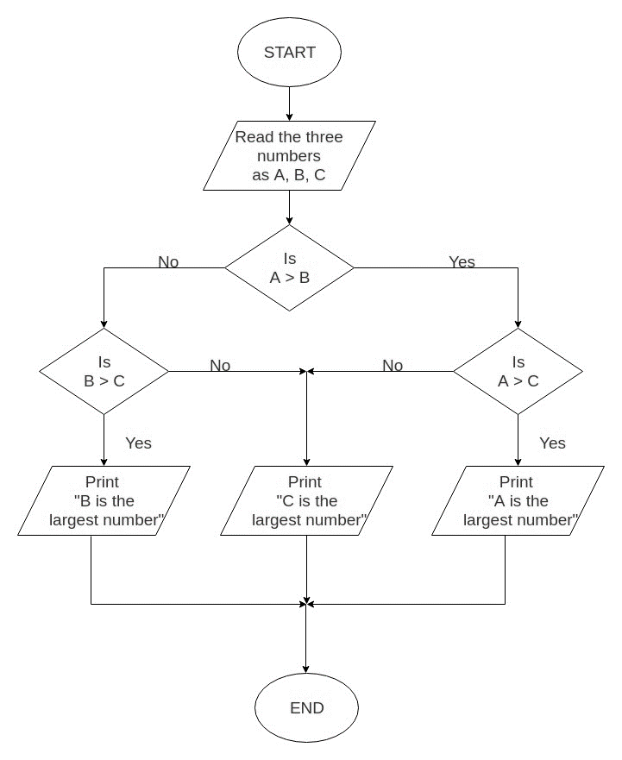
TASK
Draw flowchart to find the largest among three different numbers entered by user. Let say the numbers are A, B and C.

Slide 72
TASK
Write an algorithm and also draw flowchart for calculate factorial value of a number:

Slide 73
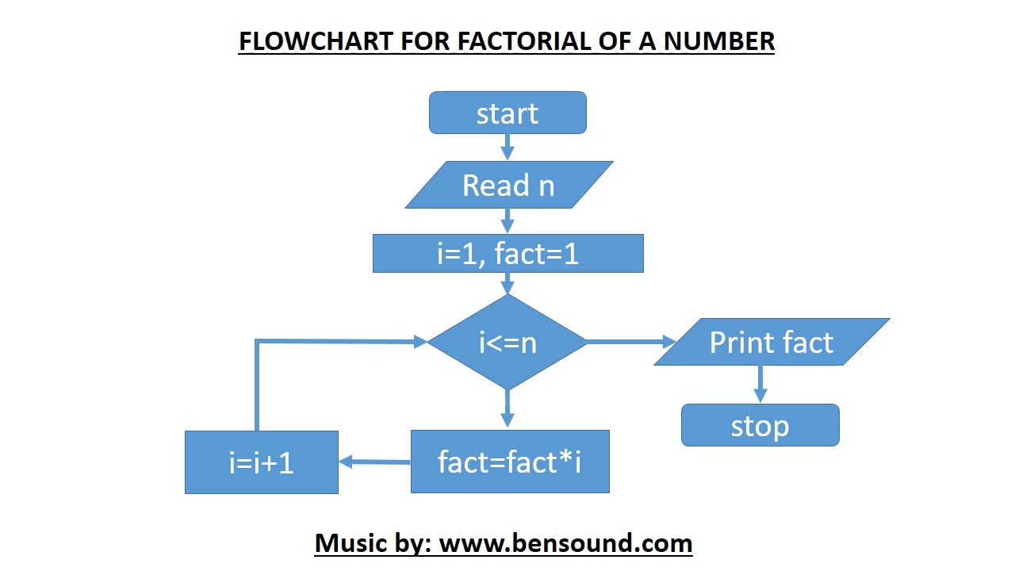
TASK
Write an algorithm and also draw flowchart for calculate factorial value of a number:
step 1. Start step 2. Read the number n step 3. [Initialize] i=1, fact=1 step 4. Repeat step 4 through 6 until i=n step 5. fact=fact*i step 6. i=i+1 step 7. Print fact step 8. Stop

